Slide 1
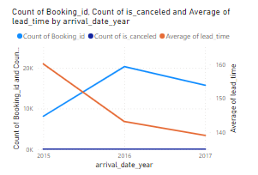
Power bi report
Booking Trends Over Years: There are visualizations showing the count of booking IDs, cancellations, and average lead times by year. This suggests a comparison of booking activities and customer behavior over different years.

Slide 2
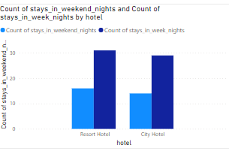
Stay Durations: Charts compare the count of stays in weekend nights versus weekday nights by hotel type (Resort and City Hotel), indicating customer preferences for the duration of stay based on hotel type.

Slide 3
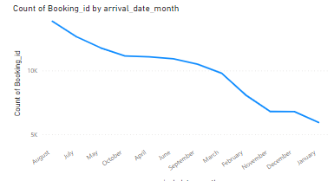
Monthly Booking Patterns: A visualization shows the count of booking IDs by arrival date month, which can be used to identify peak booking periods throughout the year.

Slide 4
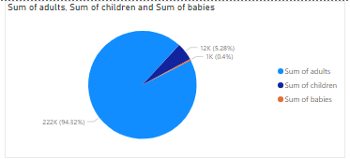
Guest Distribution: A chart illustrates the sum of adults, children, and babies involved in bookings, giving insight into the guest composition.

Slide 5
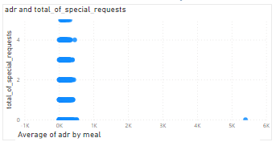
ADR and Special Requests: There's a connection between the average daily rates (ADR) and the total number of special requests made by guests. This could indicate how additional services impact pricing.

Slide 6
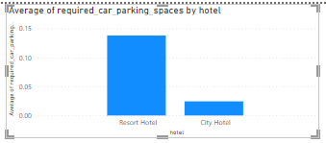
Car Parking Needs: A bar chart shows the average required car parking spaces by hotel, which can be useful for facilities planning.

Slide 7
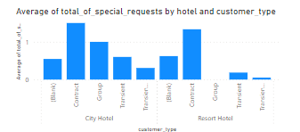
Special Requests Analysis: This seems to be analyzed by hotel and customer type, which would help in understanding customer needs and preferences

Slide 8
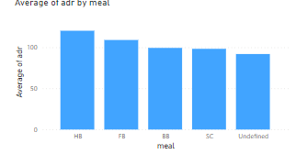
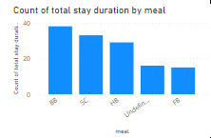
Meal Plan Analysis: There are visuals related to meal plans, such as the count of total stay duration by meal and average ADR by meal, as well as the distribution of meal plans across different booking channels.

Slide 9
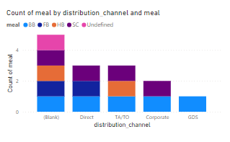
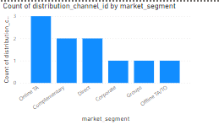
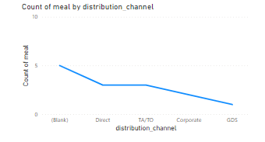
Market Segment Analysis: There's a chart showing the count of booking IDs by market segment, which would help in market analysis and strategy development.

Slide 10
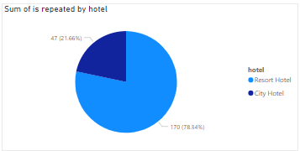
Repeated Guest Analysis: A chart illustrates the sum of repeated guests by hotel type, which could be important for customer loyalty programs.

Slide 11
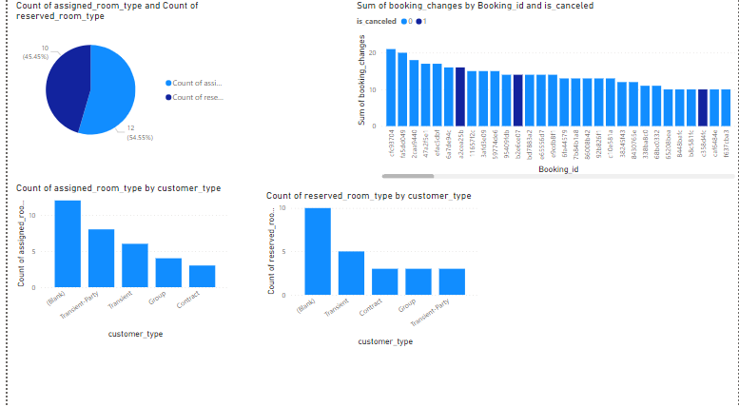
Room Type Preferences: Visualizations compare the count of assigned room types and reserved room types, as well as their distribution by customer type.

Slide 12
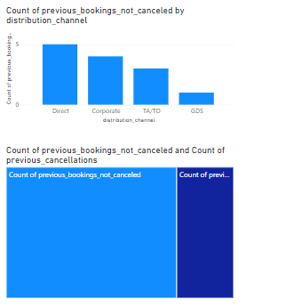
Booking Changes and Cancellations: There are visuals that seem to explore the correlation between booking changes and cancellation likelihood.

Slide 13
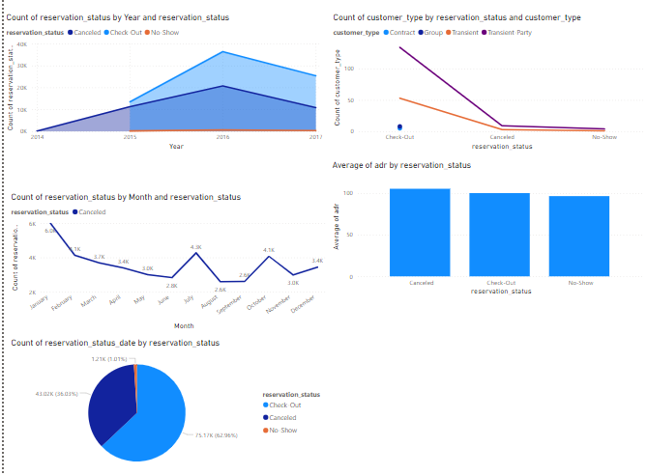
Reservation Status Analysis: Several charts provide an overview of reservation statuses (canceled, checked-out, no-show) over time and by year, as well as by customer type and month.

